Slide 1



Shield Insurance
Presented By : Kanchan Sinha
AtliQ Technologies

Slide 2
Table of Contents
Company Overview
Dashboard
Objective
Key Insights
Data Model
Recommendations

Slide 3
Company Overview
Shield Insurance is a leading insurance provider in India, operating across Mumbai, Delhi NCR, Chennai, Hyderabad, and Indore.
It offers nine diverse policy types through multiple sales channels, including Offline Agents, Direct Sales, Mobile Apps, and Websites.
03
02

Slide 4

Understand customer distribution based on age groups and policies purchased.
Identify high-performing policies and customer segments.
01
Objective
Evaluate the effectiveness of different sales channels
02
Provide data-driven insights to support strategic business decisions.
Enhance operational efficiency and improve customer targeting.
03

Slide 5

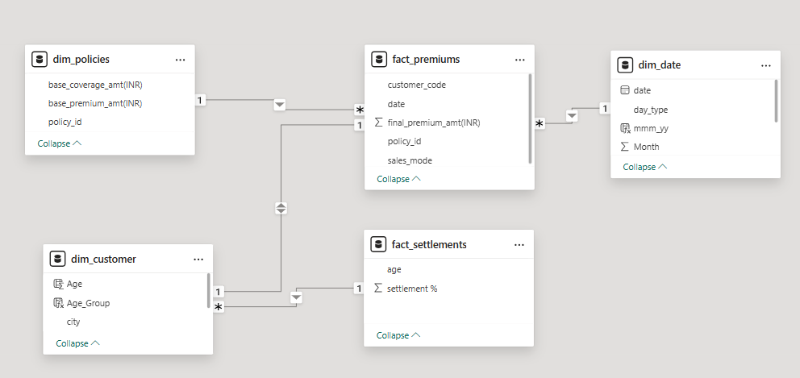
Data Model
Dimension Table
Dim_date
Dim_customer
Dim_policies
Fact Table
Fact_premiums
Fact_settlements
Data set from Nov 2022 to Apr 2023

Slide 6
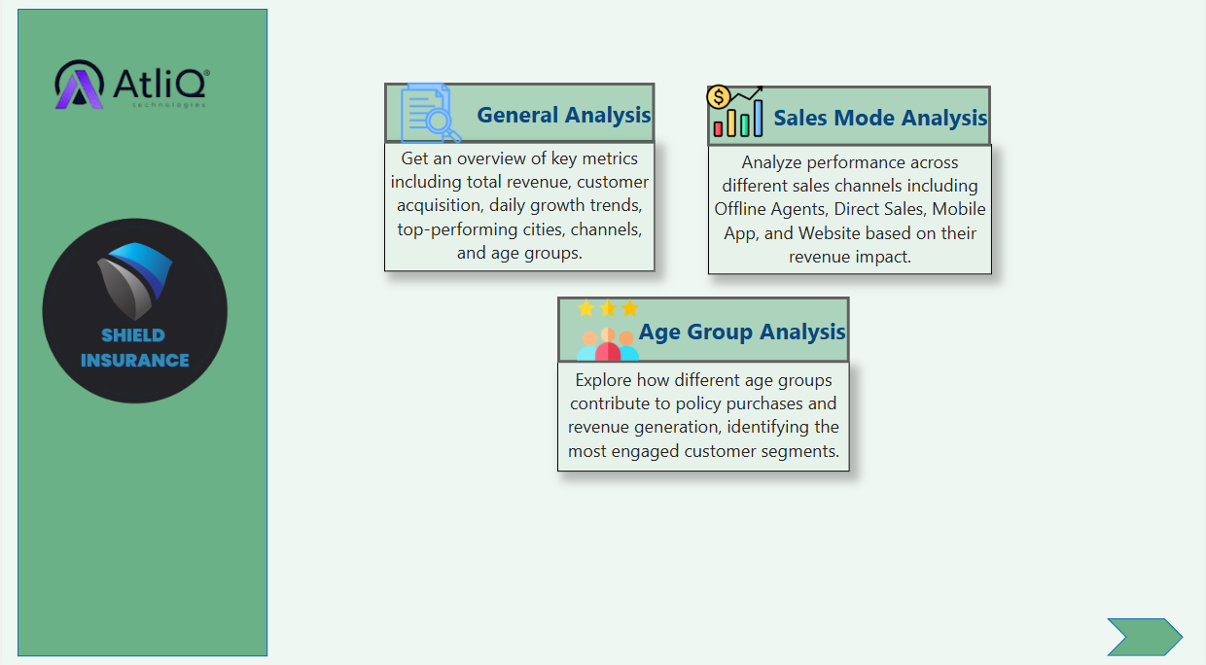

Slide 7
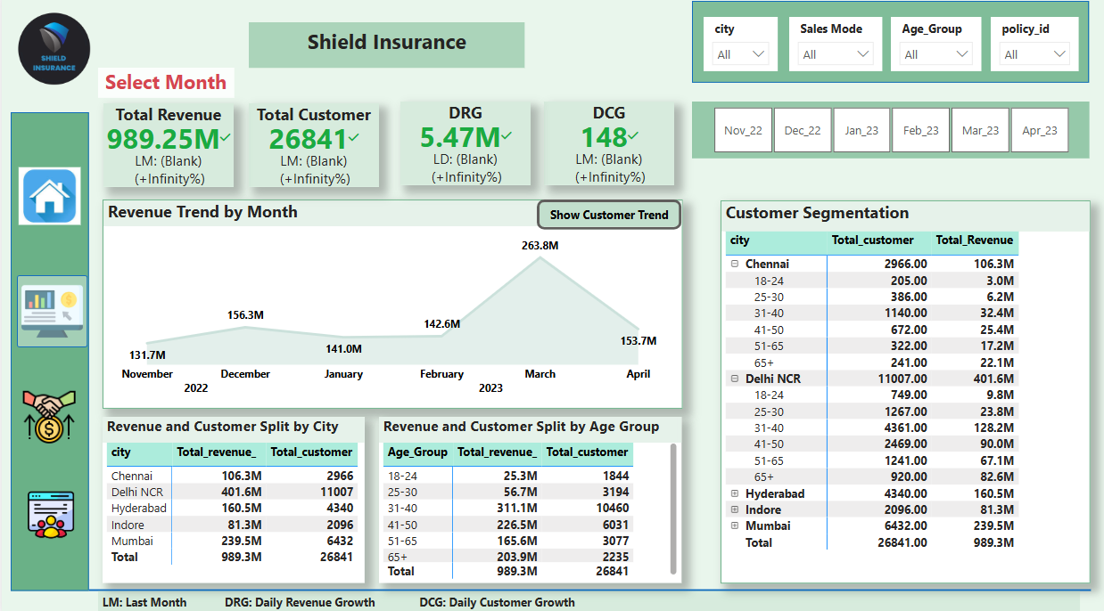
General Analysis

Slide 8
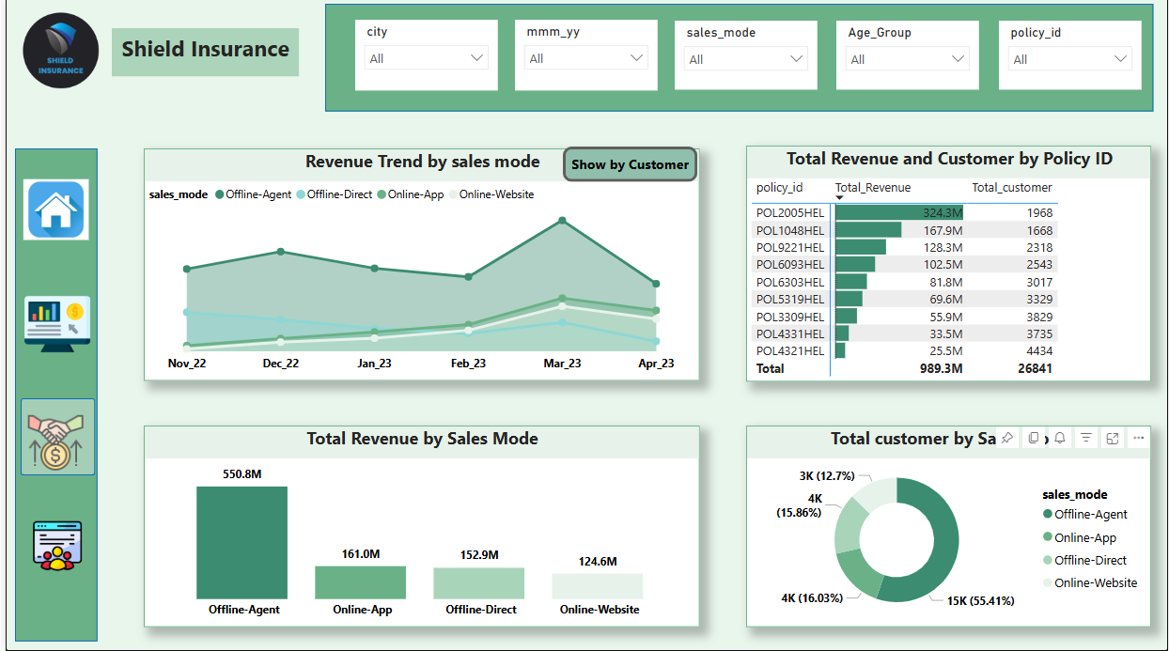
Sales Mode Analysis

Slide 9
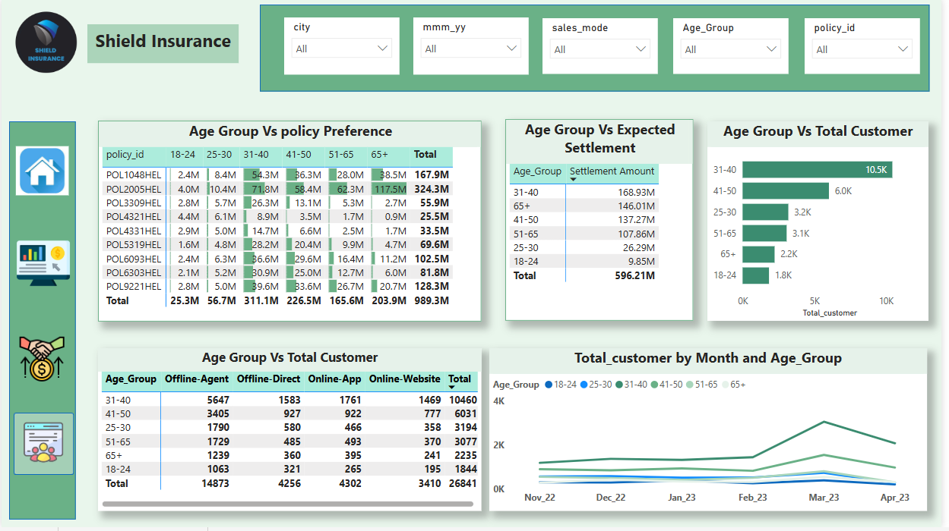
Age Group Analysis

Slide 10
Key Insights
Shield Insurance generated ₹989.25 Million in revenue from 26,841 customers.
The business is growing steadily with a daily revenue growth of ₹5.47 Million and 148 new customers on average per day.
Delhi NCR, Mumbai, and Hyderabad emerged as the top-performing cities, leading in both revenue generation and customer acquisition. Together, they contribute 81% of the total revenue.
March 2023 was the best-performing month, generating ₹263.8 Million in revenue and acquiring a total of 7,081 customers.
Offline Agents were the most effective sales channel, generating ₹550.8 Million in revenue, acquiring nearly 15,000 new customers, and contributing the highest to expected claim settlements.
The age group 31–40 purchased the highest number of policies, with a total of 10,460 policies sold.

Slide 11
Recommendations
Strengthen Presence in Top Cities: Focus on high-performing cities like Delhi NCR, Mumbai, and Hyderabad, where both revenue and customer acquisition are highest, to further increase market share.
Enhance Support for Offline Agents: Since Offline Agents are the most effective sales channel, invest in training, tools, and incentives to maintain and improve their performance.
Target High-Performing Age Group: Design targeted campaigns for the 31–40 age group, which has shown the highest policy purchases, to maximize conversions.
Leverage Peak Months for Campaigns: Capitalize on high-performing months like March with special offers or marketing campaigns to maintain momentum.
Promote Steady Growth Strategies: With consistent daily revenue and customer growth, continue optimizing customer experience and retention strategies to sustain upward trends.

Slide 12


THANK YOU

